Slide 1
SOMEWHAT WEIRD THOUGHTS

Slide 2


Pritammishra.com
STARTING A REALITY SHOW
EX-FACTOR : All your ex’s at one place.
Enough!, show cancelled, f**off
Enough!, let’s go to next round
Round-02
Round-01
One word about me
Me in bed
Jerk!
Weirdo
2 mins, foreplay included!
………

Slide 3



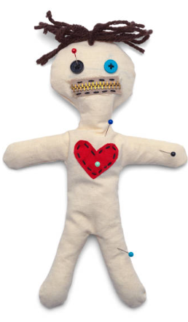
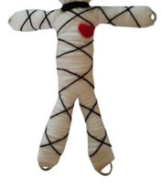
Pritammishra.com
Creating Voodoo doll of a voodoo doll
This voodoo thing is nons…..Ouch ouch!
Let’s see if it reaches martha!
Ouch! Wtf!

Slide 4
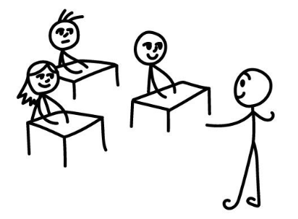

Pritammishra.com
Clarifying doubts
No way 10k!
No Brian, pedometer doesn’t count pedophiles

Slide 5


Pritammishra.com
Perspective: Understanding generation gaps.
Daddy, LGBTAIQ++
Momma rainbow, wow!

