Slide 1
SOLVING RELIGIOUS CONFLICTS

Slide 2
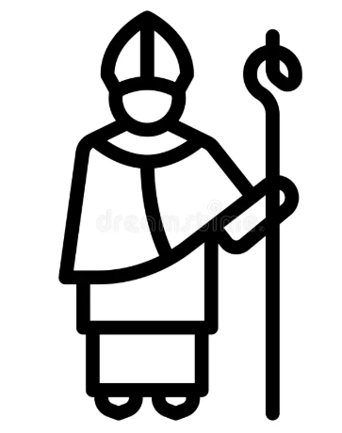

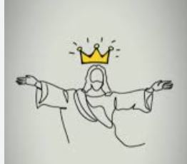

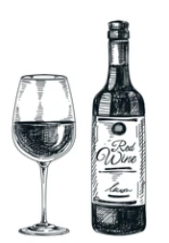
BELIEVE THE BELIVABLES!
Always remember the golden rule: they are all right!
My guy, turned water into wine!
Sure, he Did!

Slide 3
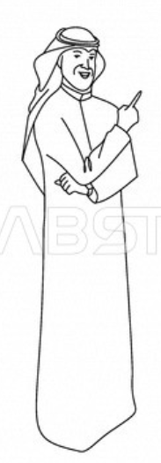

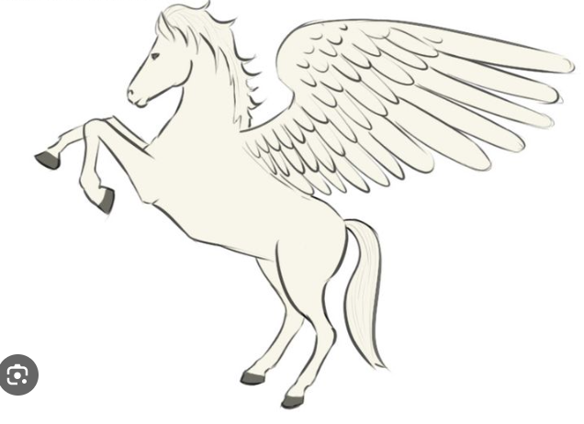
My guy went to heaven on a winged horse!
Sure, he Did!
To heaven plz!

Slide 4
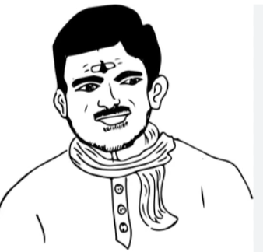
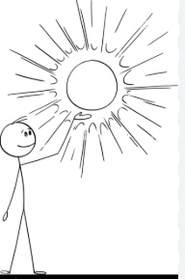
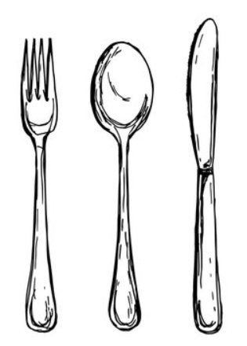
Sure, he Did!
My guy almost ate the sun, when he was a kid
Momma, it’s hot!, I will have it later!

Slide 5
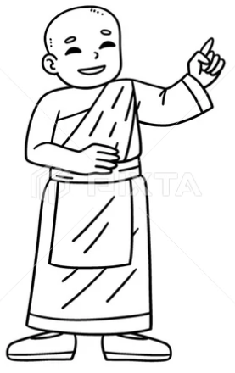
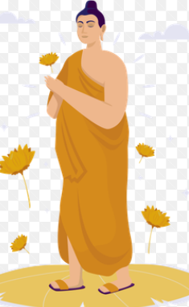

Sure, he Did…No , wait what?
My guy almost ate the sun, when he was a kid
Time for meditation, See ya!
Dear lord, what is the meaning of life?

