Slide 1
Mildly Inappropriate Company Policies

Slide 2
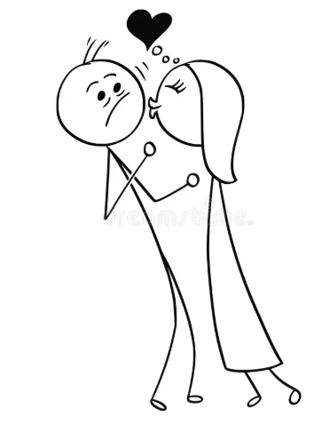
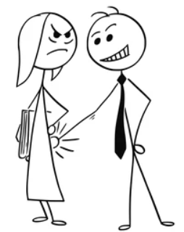

POSH
Strict policy against POSH.
Cuz Dignity of women is everything.
Strict action against POSH complaints (below vice –president level).
✔️
✔️

Slide 3

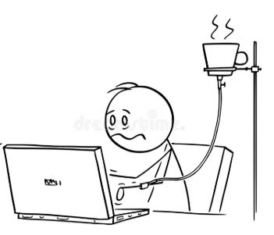

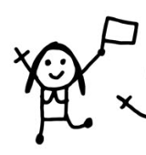

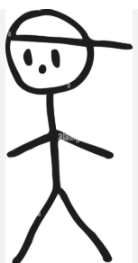
MATERNITY LEAVES
Maternity leaves are right of a woman and we take it very seriously in this organization.
now Get that shit done!!
Not Again, Martha!
+6
James
+18
+24
+12
James
“Whoever has will be given more” ~Matthew 13:12

Slide 4

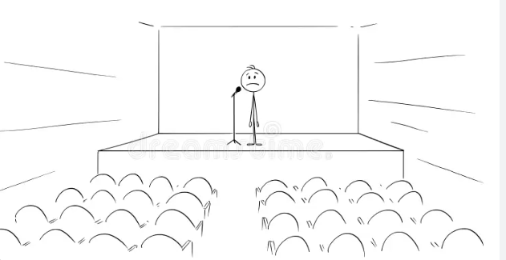
Environment policy
Cuz A day without sustainability is a day wasted.
It’s my pleasure to announce quarterly performance. Our carbon foot print is net zero. So is our sales.
Carbon footprint every 5 sec. Sustainability every 10 sec. Ok?

Slide 5
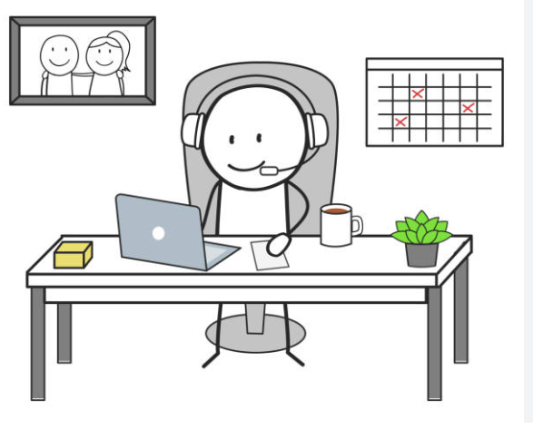
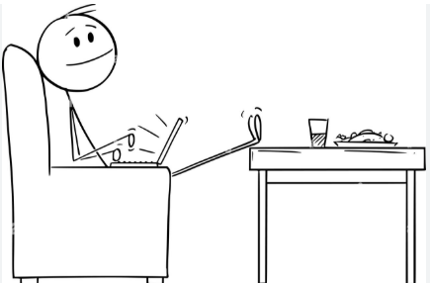
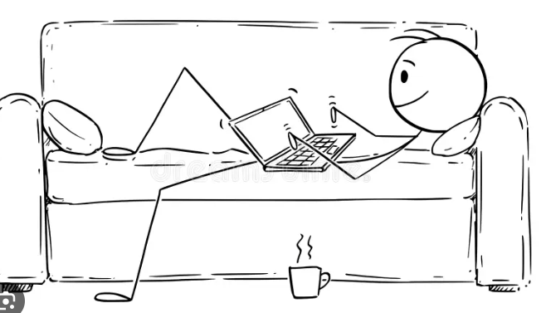

Pritammishra.com
Work from Home Policy
Research suggests it improves productivity many fold.
11:00
11:02
11:03
11:05
*Productivity of your competitors.

Slide 6
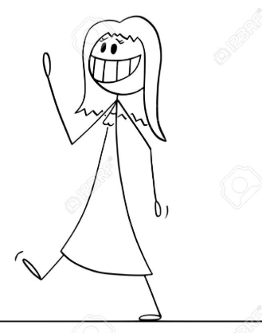
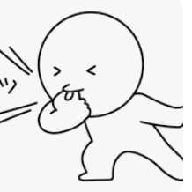

Whistleblower Policy
Pritammishra.com
Important to protect the whistleblowers and duly rewarding them for upholding the integrity of the organization.
Where ya goin, sweety, I’m here!
Employee of the year

