Slide 1
MAKING STORIES INTERESTING

Slide 2
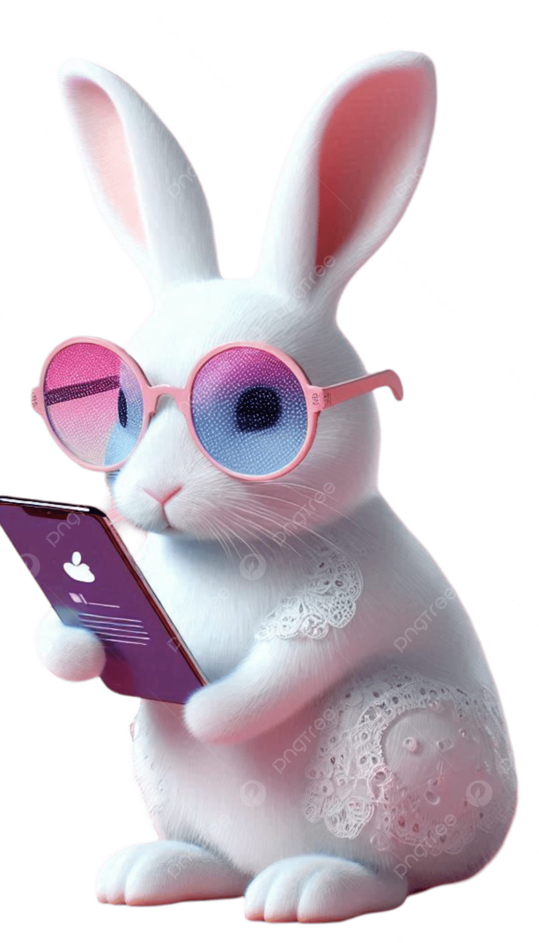
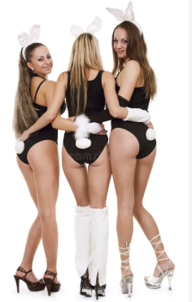
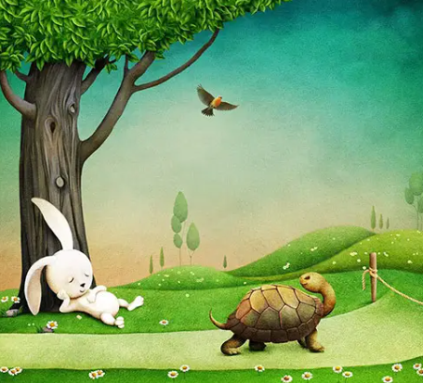
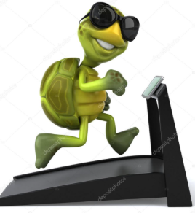
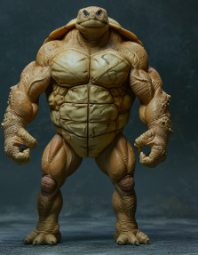

Your Gen Z++ kids will never like the old stories.
Spice it up and be a kewl Dad!
The Tortoise and the Hare
Timmy the turtle and the Reynolds the rabbit (they/them)
Rabbit fall asleep, tortoise kept on racing and won
Reynolds got distracted by Instagram models
Timmy practiced on treadmills
Didn’t work→ took steroids → won race

Slide 3

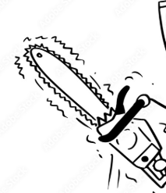
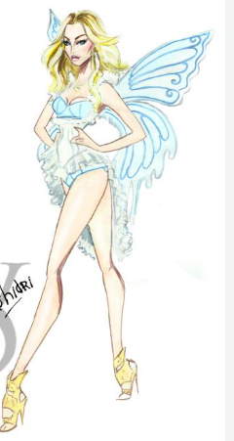
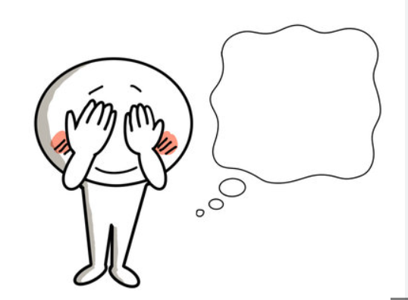

The Honest woodcutter
The Distracted woodcutter
Lost his axe
Blondie gives her Golden and Silver axe
Says No, asks his wooden one-→ gets all three and the blondie.
Victoria secrets angel:
• Is this golden chain saw yours?
• Is the silver one yours?
Which chain saw?

Slide 4
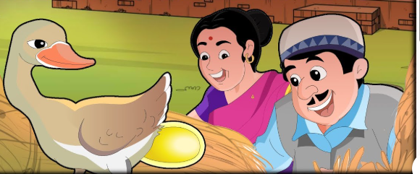


The Golden Goose
The Golden Button goose
Gave one golden egg every day.
Guy went technologia: I will take em all today.
Goose dies.
Killed over diamond button

Slide 5
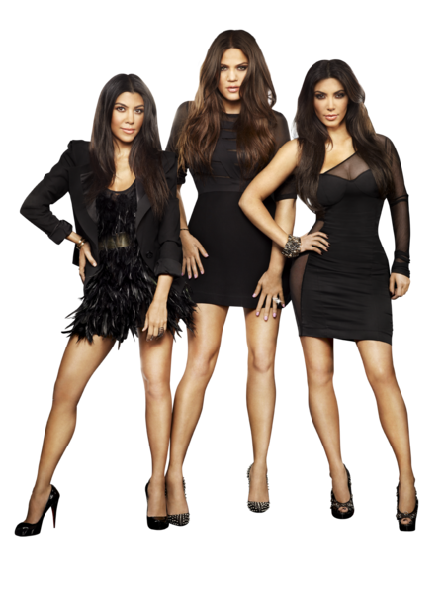
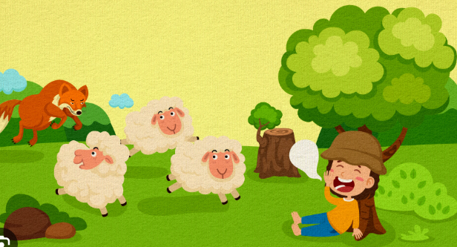
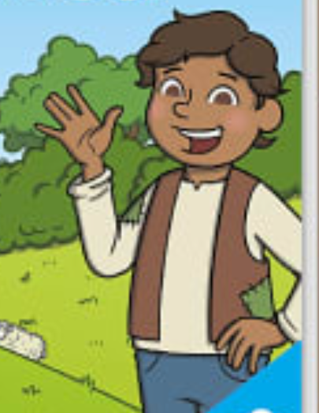
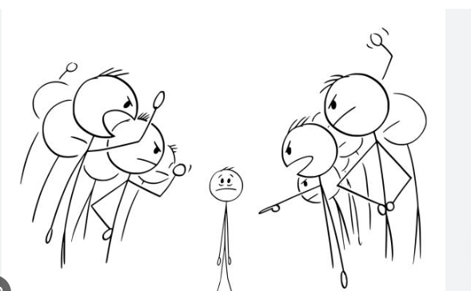
The Boy Who Cried Wolf
The Boy who cried kardashians
Local Nutter
Shouted “wolf is here” for willy nilly
Came one time for real, whupped his ass.
No one saved
Local nutter: Who kept up with kardashians
Shouted “Kardashians are here” for willy nilly
All Came one time for real
Everyone whupped him for not calling them.
Why you didn’t call us?

