Slide 1
GUIDE FOR OLD LADS STRUGGLING IN RELATIONSHIP

Slide 2


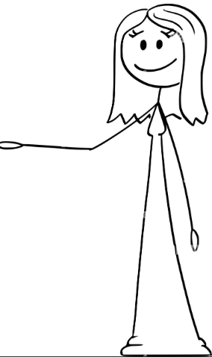
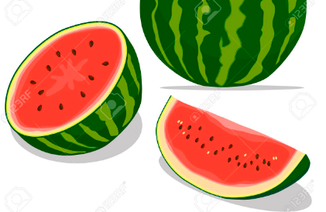
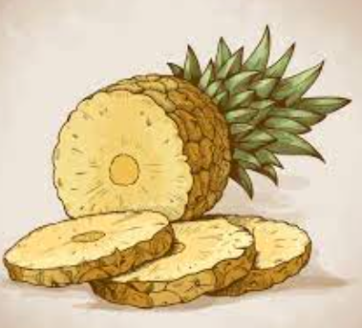
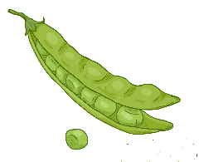


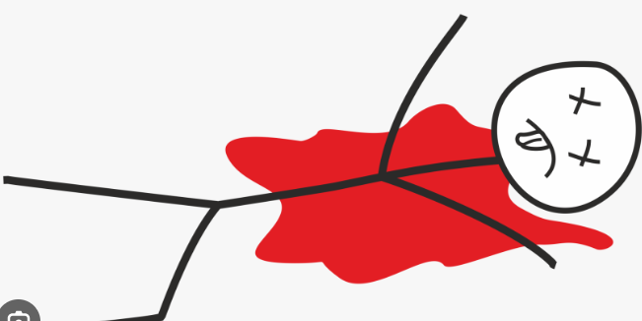
1. BUILDING TRUST
METHOD-01: TRUST EXERCISES
YOU CAN
TRUST HER NOW
NEXT
NEXT

Slide 3
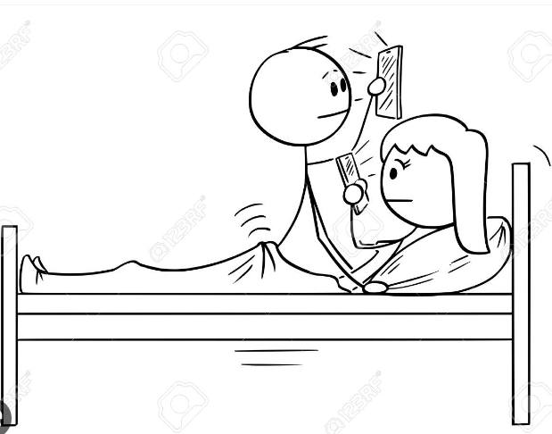
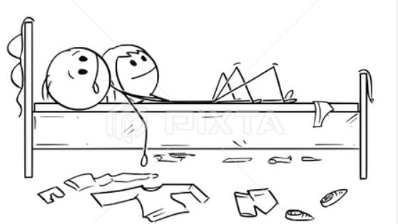


1. BUILDING TRUST
METHOD-02: OPEN COMMUNICATION
Hi Honey, I am with your bestie!
Hi love, I will be late!
Ok TC dear!
I am with yours btw
Me too!

Slide 4
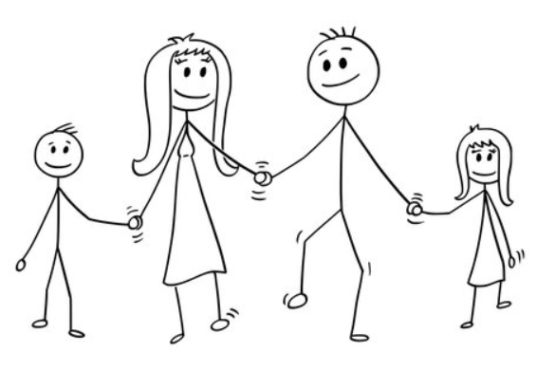
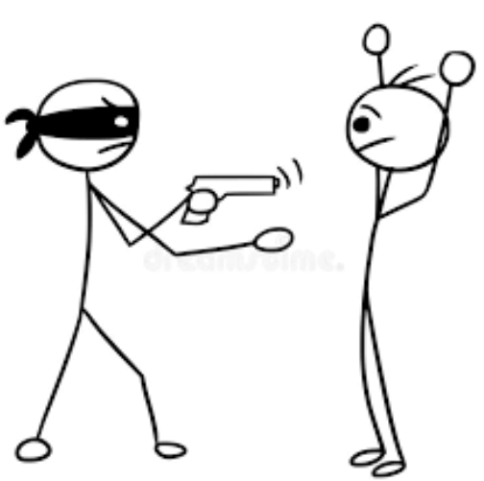
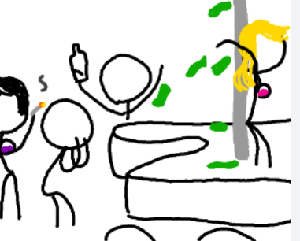
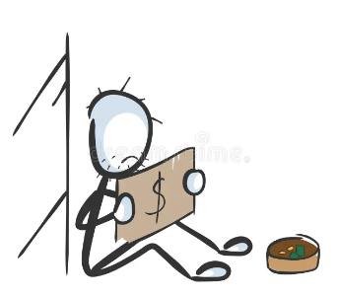
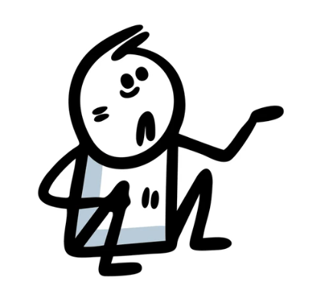
2. MONEY PROBLEMS
DON’T BLAME ONE PERSON
Always remember: WE ARE FAMILY, WE ARE IN THIS TOGETHER, We’ve got this!
If there is a will, there is a way.

Slide 5
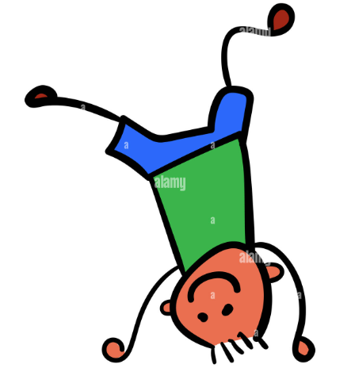
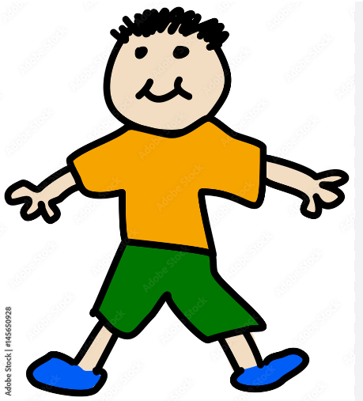

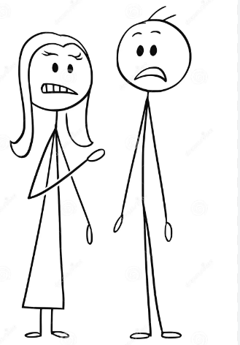
3. ARGUMENTS
MOST ARGUMENTS ARE TRIVIAL AND CAN BE RESOLVED AMICABLY
No!! Kids will not wear those t-shirts
But it’s for everyone's ease!!
UP FOR
ADOPTION
RETARD
SANE
ONE

Slide 6
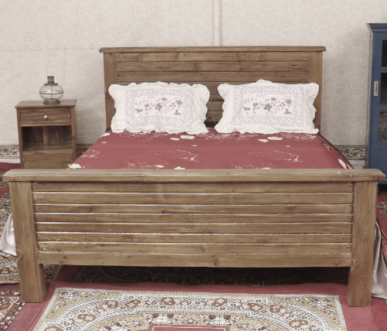
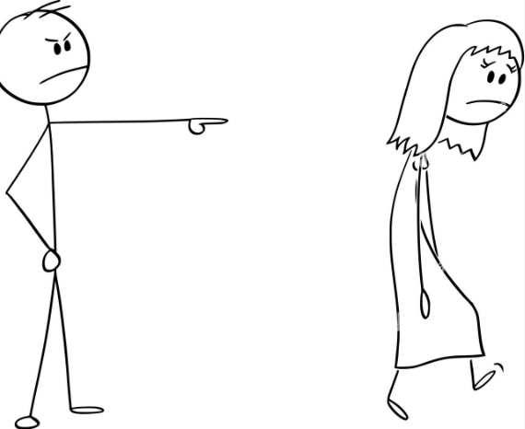
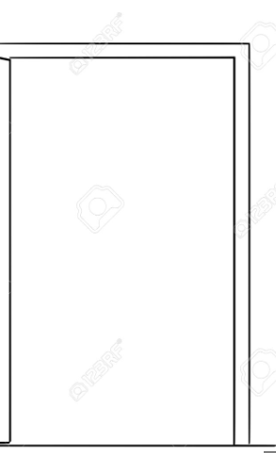


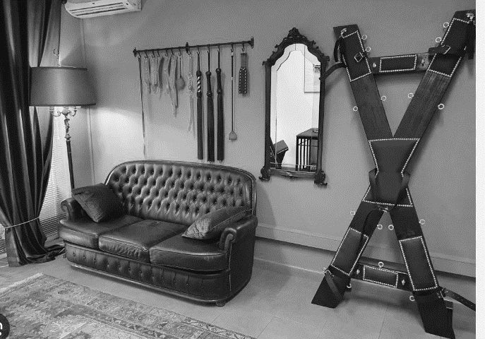
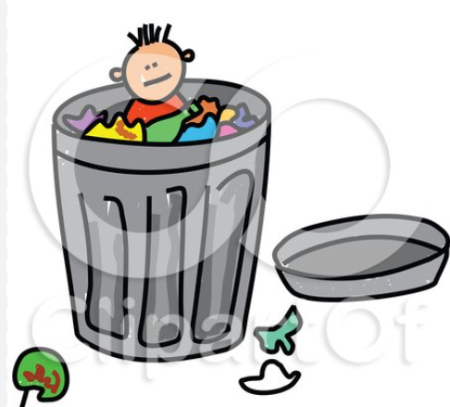
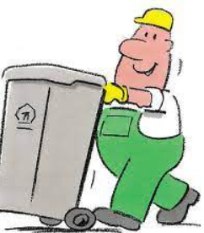
4. HEALTHY ENVIRONMENT
A Healthy relationship is result of healthy environment and it starts with you
SHARE POSITIVITY
Change Boring interiors
Get Rid of Negativity
Honey, It says “positive” against HIV

