Slide 1
GUIDE FOR NEW LADS TO FIND PERFECT MATCH

Slide 2






STEP-01: FINDING THE RIGHT TYPE
BE CLEAR ABOUT WHAT YOU WANT.
But HOW???
BEAUTY | BRAIN | BOOBS
0 | 0 | 0
0 | 0 | 1
0 | 0 | 0
0 | 0 | 1
1 | 1 | 0
1 | 1 | 1
1 | 1 | 0
1 | 1 | 1
SUCCESSFUL | SENSE OF HUMOUR | SIZE
0 | 0 | 0
0 | 0 | 1
0 | 0 | 0
0 | 0 | 1
1 | 1 | 0
1 | 1 | 1
1 | 1 | 0
1 | 1 | 1
Me
Her
3B Theory
For regular Guys. * AND Girls not into solids.
3S Theory
For regular Girls * AND Guys into solids.

Slide 3



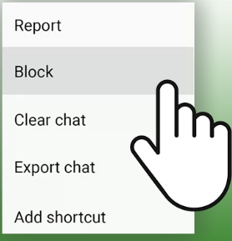
STEP-02: LOOK FOR HINTS
SOME HINTS THAT TELLS “SHE IS TOTALLY INTO YOU.”
Texts you: “Hi”, “Hmm”, “I am busy”, “Bye”
She Looks at your general direction
Once laughed at your joke

Slide 4

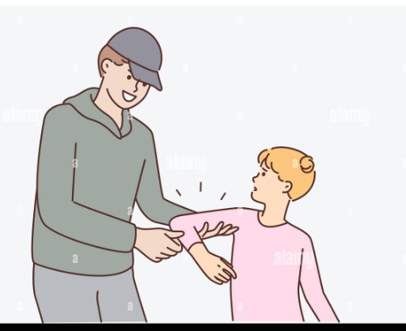

STEP-03: ASKING HER OUT
Time to be a thorough Gentleman
Different girls, Different approach.
or
or

Slide 5

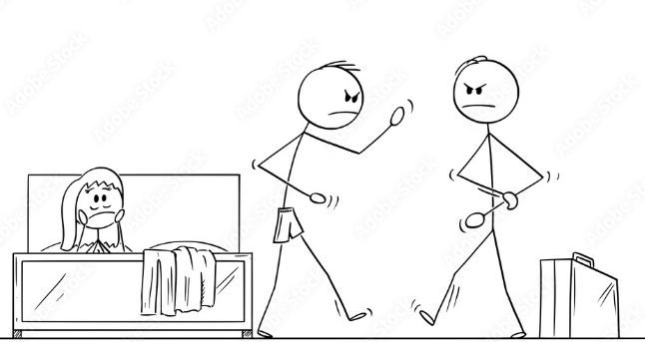






STEP-04: MAKE HER FEEL SPECIAL
REACH OUT.
SURPRISE VISITS.
GIFTS.
Hello,
Send Noods!
Aww this is so special
Thanks, but I don’t like chocolates
3 months before

